Slide 1
Tuple
Tuples are used to hold together multiple objects. Think of them as similar to lists, but without the extensive functionality that the list class gives you.
One major feature of tuples is that they are immutable i.e. you cannot modify tuples.
Tuples are usually used in cases where a statement or a user-defined function can safely assume that the collection of values i.e. the tuple of values used will not change.

Slide 2
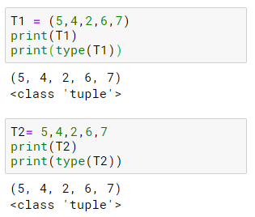
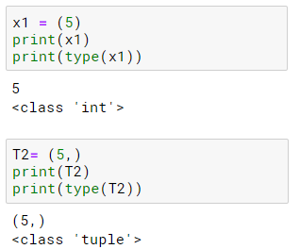
Tuple Creation
Tuples are defined by specifying items separated by commas within an optional pair of parentheses.
Tuple with only single element is defined by specifying item with comma within an optional pair of parentheses.

Slide 3
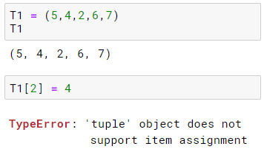
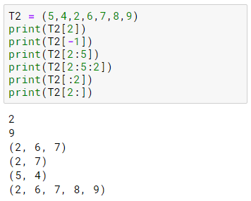
Tuple Manipulation
Tuple are immutable.
Tuple elements can be accessed by indexing and slicing methods.

Slide 4
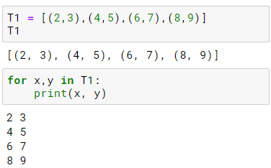
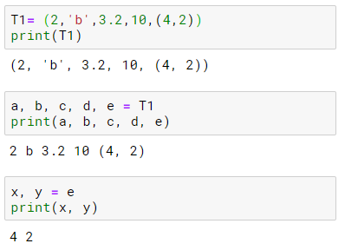
Tuple Unpacking
Unpacking allows assigning multiple values at a time.
Tuples unpacking is also applicable to loops.

Slide 5
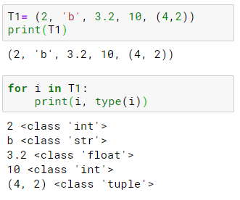
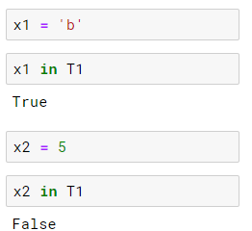
Traversal and Membership in Tuples
Traversal :
Membership :

Slide 6
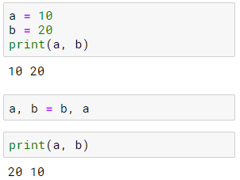
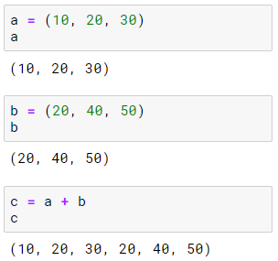
Tuple Examples
WAP for swapping two numbers.
WAP to concatenate two tuples.

Slide 7
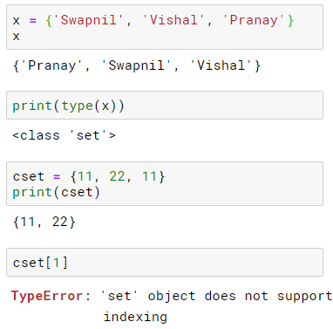
Sets
A set is unordered list of elements indentified by curly braces.
It is mutable like List.
It can only contain unique elements
Duplicates are eliminated in set.
Set do not support indexing.

Slide 8
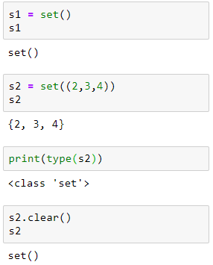
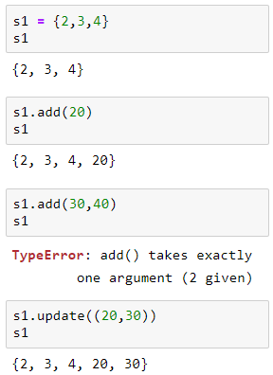
Set class Methods
Creation methods
New elements addition

Slide 9
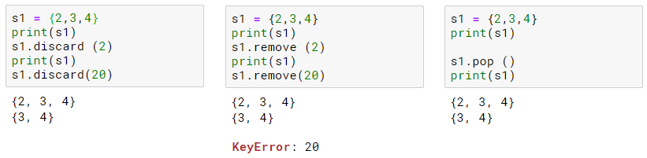
Set class Methods
Deletion Methods – discard (without error), remove , pop
WAP to remove the duplicates from given list L = [23,33,33,23,45,67,56,67,45]

Slide 10
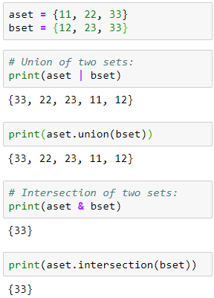
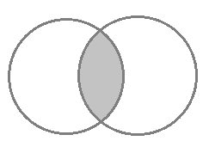
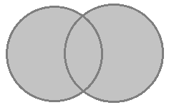
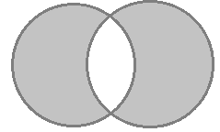
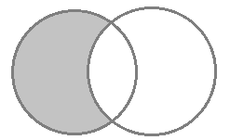
Boolean Operations on Sets
A B
A B
11,
22
12,
23
11,
22
12,
23
33
33
Union
Intersection
A B
A B
11,
22
33
12,
23
11,
22
12,
23
33
Symmetric Difference
Difference

Slide 11
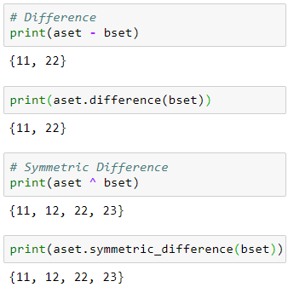
Boolean Operations on Sets
A B
A B
11,
22
12,
23
11,
22
12,
23
33
33
Union
Intersection
A B
A B
11,
22
33
12,
23
11,
22
12,
23
33
Symmetric Difference
Difference

Slide 12
Dictionary
A dictionary is like an address-book where you can find the address or contact details of a person by knowing only his/her name i.e. we associate keys (name) with values (details).
Note that the key must be unique just like you cannot find out the correct information if you have two persons with the exact same name.
One can use only immutable objects (like strings) for the keys of a dictionary but can use either immutable or mutable objects for the values of the dictionary.
This basically translates to say that you should use only simple objects for keys.

Slide 13
Dictionary
Pairs of keys and values are specified in a dictionary by using the notation
d = { key1 : value1, key2 : value2 }
Notice that the key-value pairs are separated by a colon and the pairs are separated themselves by commas and all this is enclosed in a pair of curly braces.
Remember that key-value pairs in a dictionary are not ordered in any manner. If you want a particular order, then you will have to sort them yourself before using it.
The dictionaries that we will be using are instances/objects of the dict class.

Slide 14
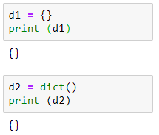
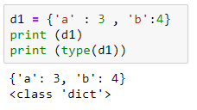
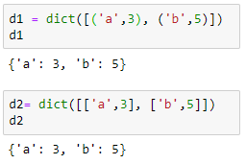
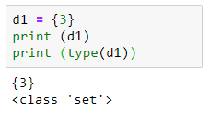
Dictionary Creation Methods
Creation methods –
List of tuple and list of list.

Slide 15
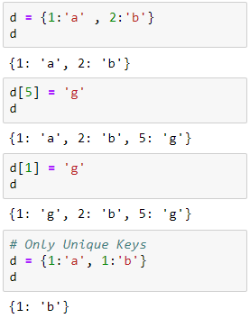
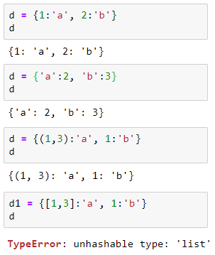
Dictionary Basic Methods
New key:value pair addition and update of values
Keys has to be immutable data types only.

Slide 16
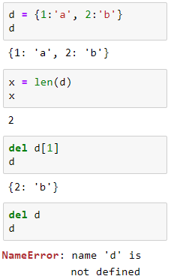
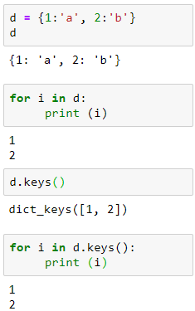
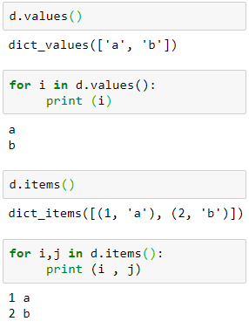
Dictionary Basic Methods
len() and del()
Other operations

Slide 17
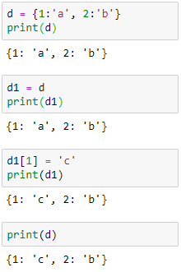
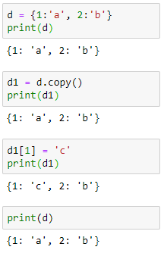
Dictionary Basic Methods
Shallow copy
Deep copy

Slide 18
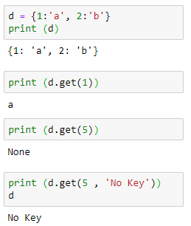
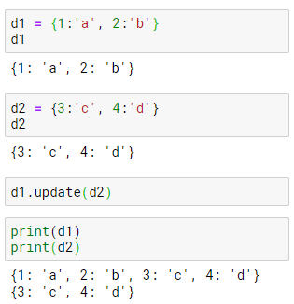
Dictionary Basic Methods
get()
update()

Slide 19
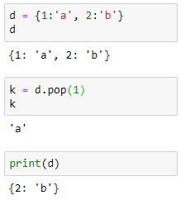
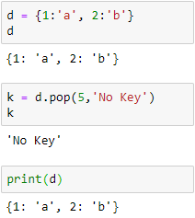

Dictionary Basic Methods
pop() operation
Dict Comprehension

Slide 20



Update element in nested data type
To replace element 5 by 55 :
To replace element 9 by 99 :

